Slide 1
New GA Orientation August 22, 2018 (Part I)
Marnie Saunders, PhD
Associate Dean, The Graduate School
Associate Professor, Department of Biomedical Engineering
Thanks to
Michelle Byrne, MA and Institute for Teaching and Learning (ITL) for co-sponsoring this event

Slide 2
Welcome
and
Thank You
for choosing The University of Akron for your graduate work

Slide 3
Welcome from Dean Midha
Chand Midha, PhD
Executive Dean of the Graduate School
and Vice Provost

Slide 4
SCHEDULE:
9:00-9:10 Graduate School Welcoming Remarks, Dean Chand Midha
9:10-9:45 - Graduate School Introduction, Marnie Saunders
9:45-10:00 - Payroll, Diane Shovestull
10:00-10:30- Code of Conduct and Title IX, Dean of Students, Michael Strong
10:30-11:00- ITL, Michelle Byrne
11:00-11:15 - Break
11:15-11:30 - Office of Inclusion, Jolene Lane
11:30-12:15 – Design and Developmental Services, Brightspace overview/demo

Slide 5
SCHEDULE Part II:
Friday, September 7th, 2018 – Student Union Theater
9:00-9:30 - Health Services, Megan Nichols
9:30-10:00 - Counseling and Testing Services, Natacha Keramidas
10:00-10:30 - Financial Aid, Amanda Paniagua
10:30-11:30 – Registrar, ZipAssist, Sarah Hamilton

Slide 6
SCHEDULE Part III:
Friday, September 21, 2018 – PEAC RM 130
9:00-10:15 - Library Services, Aimee DeChambeau
10:30-11:30 – EX[L] Center, Carolyn Behrman

Slide 7
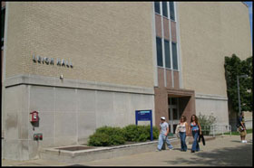
Where are we?
The Graduate School Leigh Hall, Room 515 Akron OH 44325-2101
Phone: 330-972-7663 Fax: 330-972-6475
gradsch@uakron.edu

Slide 8
Who are we?
Staff:
Heather Blake – Curriculum support
Karen Caldwell – GA Contracts
Dr Karen Greene – Admission, Graduation
Tanya Kauffman – General Support

Slide 9
About The University of Akron
Enrollment
22,104 Total
16,324 Full time
5,780 Part time
Graduate Enrollment
2,857 Full time
1,733 Part time

Slide 10
About The University of Akron
Faculty
431 Full Time Graduate Faculty
Programs
20 PhD, 73 MS and 4 JD offerings in 6 colleges and the Law School

Slide 11
About The University of Akron
Graduate Opportunities in Colleges:
College of Arts & Sciences
College of Business
College of Education
College of Engineering
College of Health Professions
College of Polymer Science and Polymer Engineering
Law School

Slide 12
Graduate Student Government
Mission
The Graduate Student Government of The University of Akron, hereby set forth to structure an effective representative graduate student government in the interests of all substantive matters pertaining to the general welfare of The University of Akron graduate students, with the intention of providing advocacy in the formulation and application of University and community policies, and with the ambition of enhancing the quality of life for all graduate students, hereby institute Graduate Student Government at The University of Akron
Graduate Student Government Student Union - Room 307C 330-972-7002 Akron, OH 44325-4601
E-mail: gsgpresident@uakron.edu
Advisor – Dr Gelleny Public Admin

Slide 13
Graduate Student Government

Slide 14
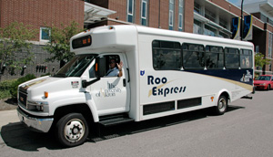
How to get around?
https://www.uakron.edu/parking/
The Roo Express Shuttle Service provides transportation to University buildings in the downtown area, neighborhoods near campus, and the parking lots on the North side of campus. During the fall and spring semesters the shuttle also services students on the weekends to and from the downtown area

Slide 15
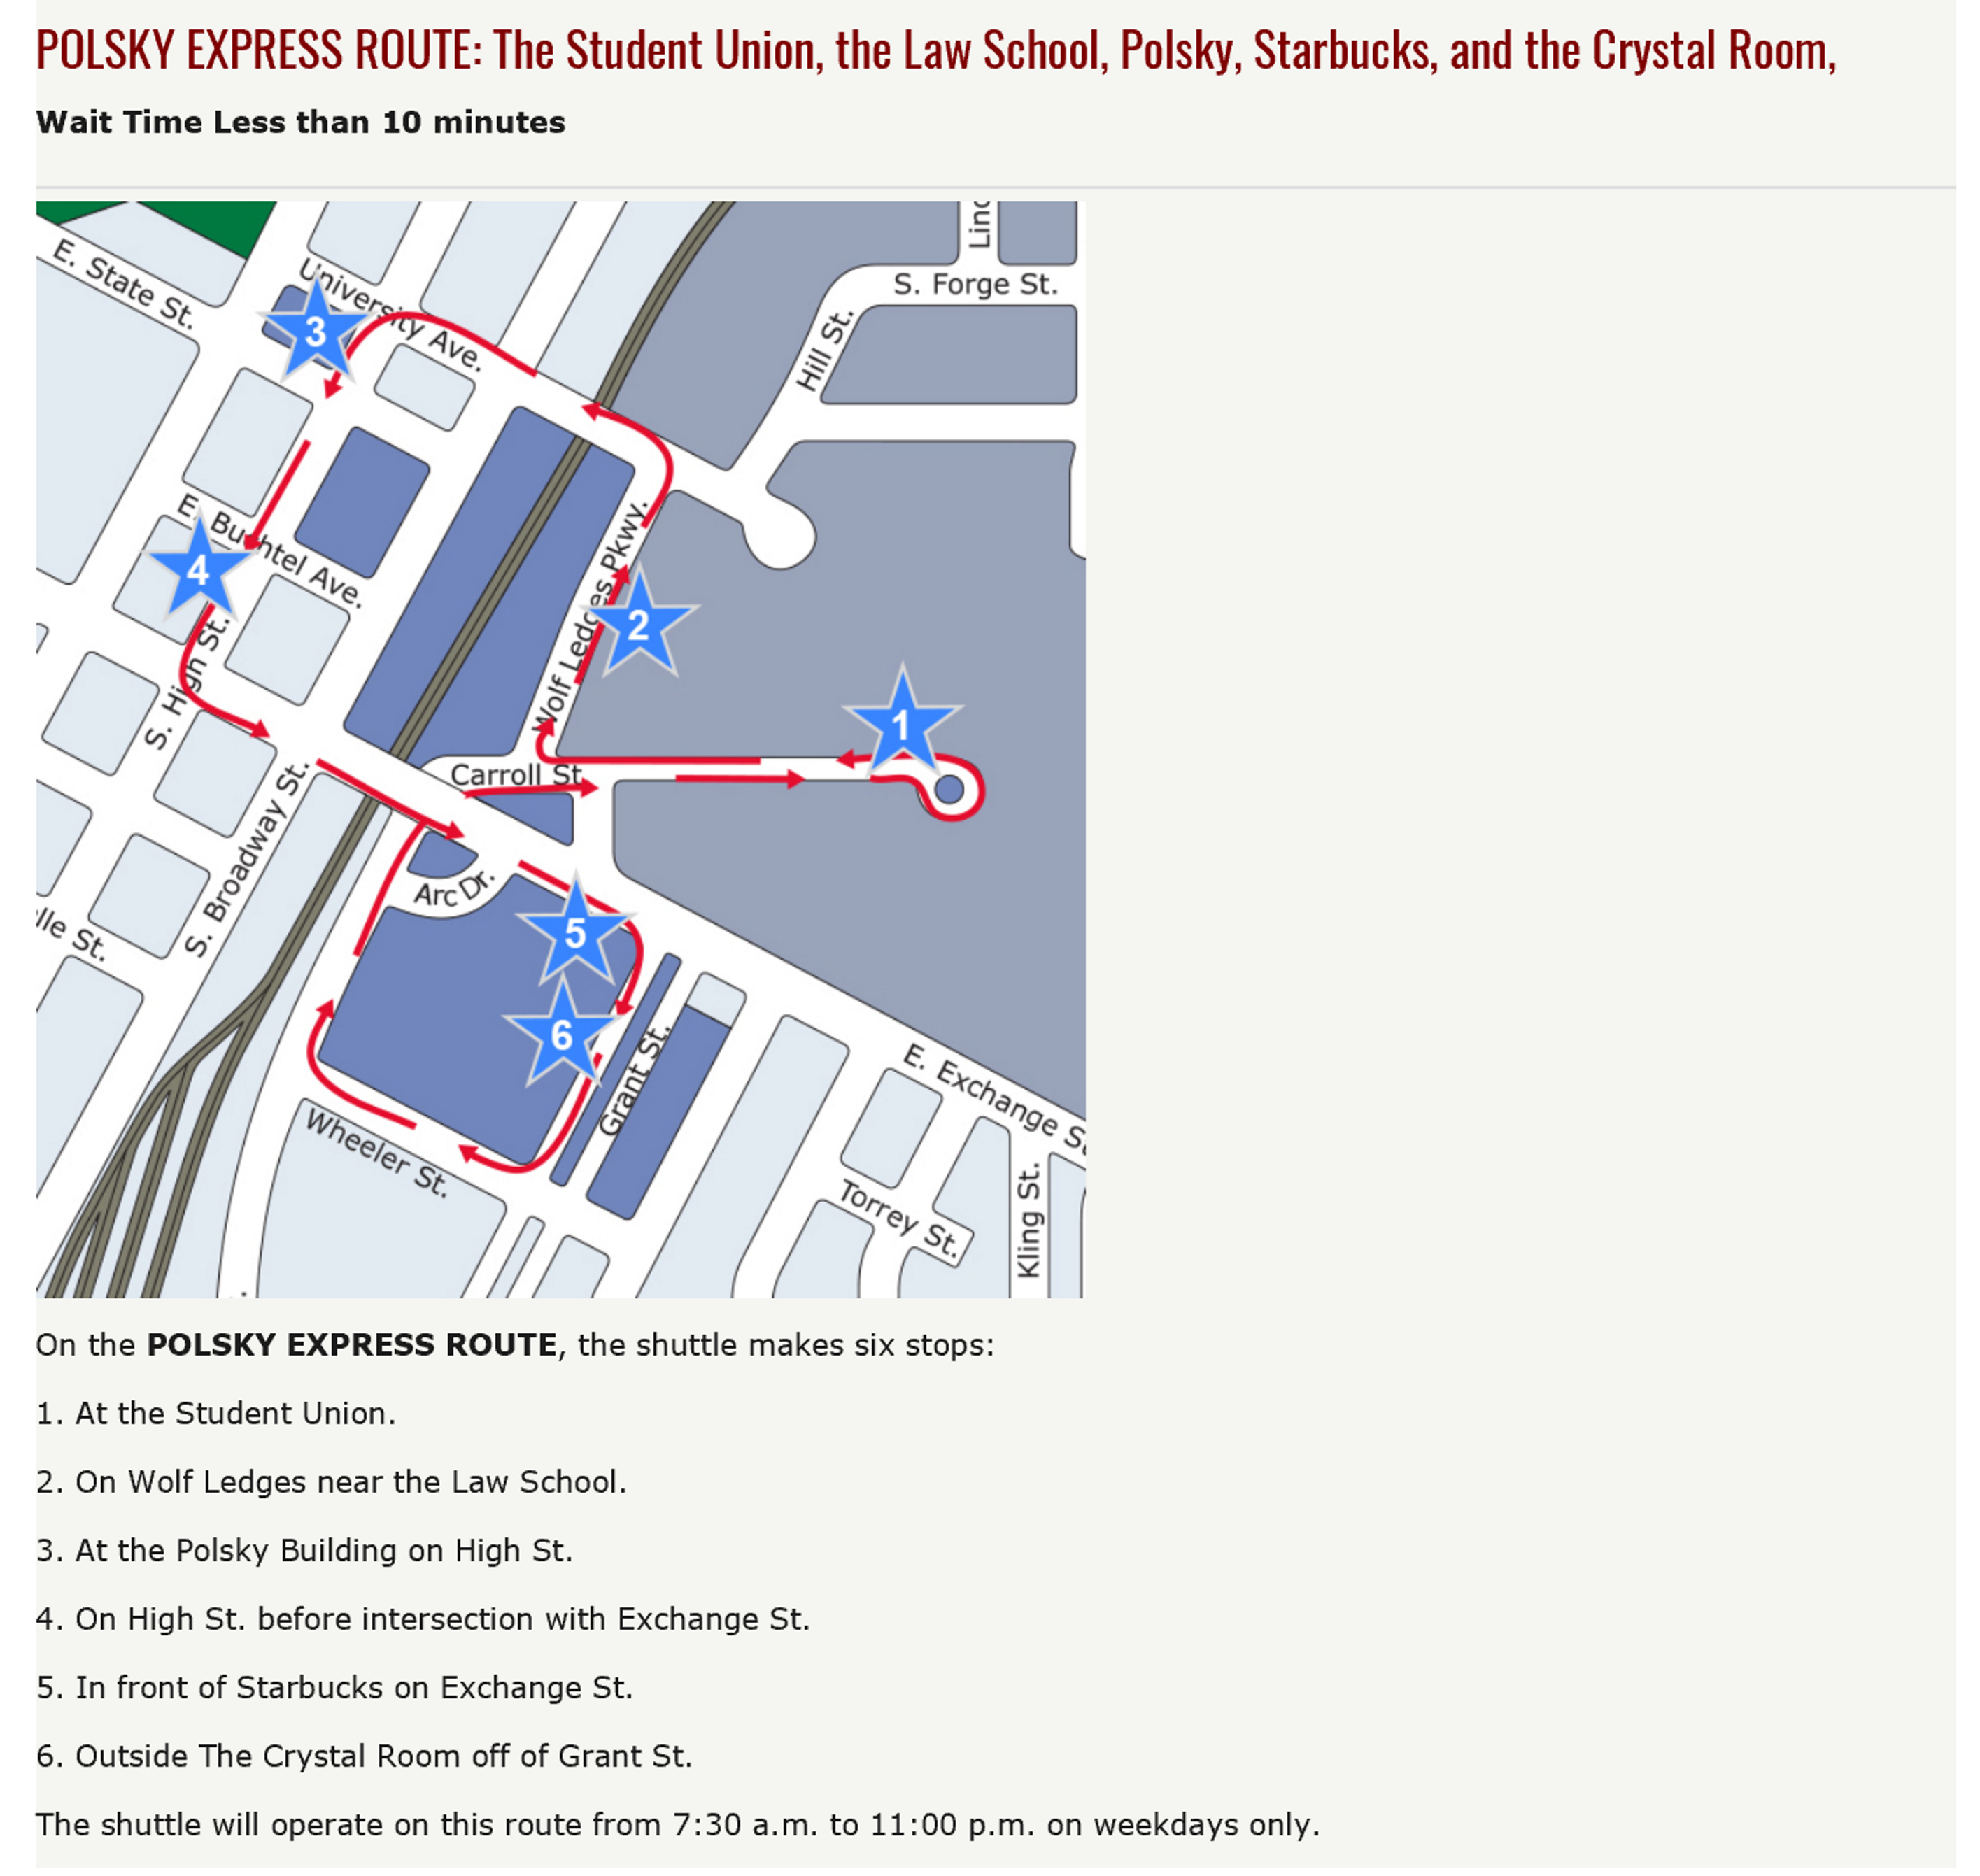
How to get around?
https://www.uakron.edu/parking/

Slide 16
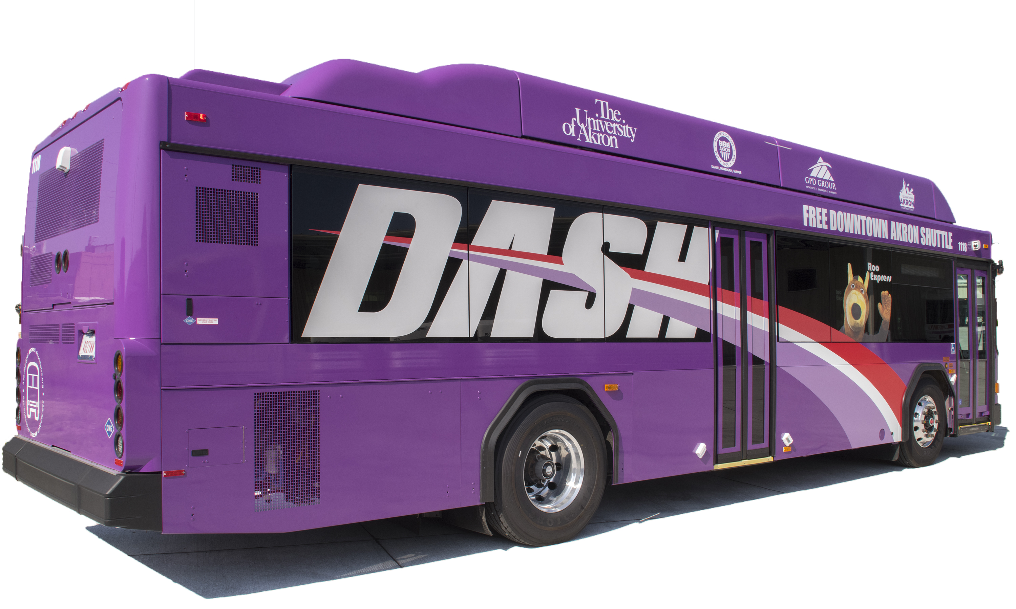
How to get around?
https://www.uakron.edu/parking/
The DASH runs approximately every 10 minutes from 7 a.m. to 7 p.m. and every 15 minutes from 7 p.m. to 11 p.m.
The University of Akron and Akron METRO RTA have collaborated to create the free Downtown Akron Shuttle (DASH), connecting various University and downtown locations. You will recognize the METRO DASH buses by their bright purple color and a picture of Zippy waving from the passenger side. This fleet of new buses feature: Free Wifi / Additional seating / Realtime bus tracking

Slide 17
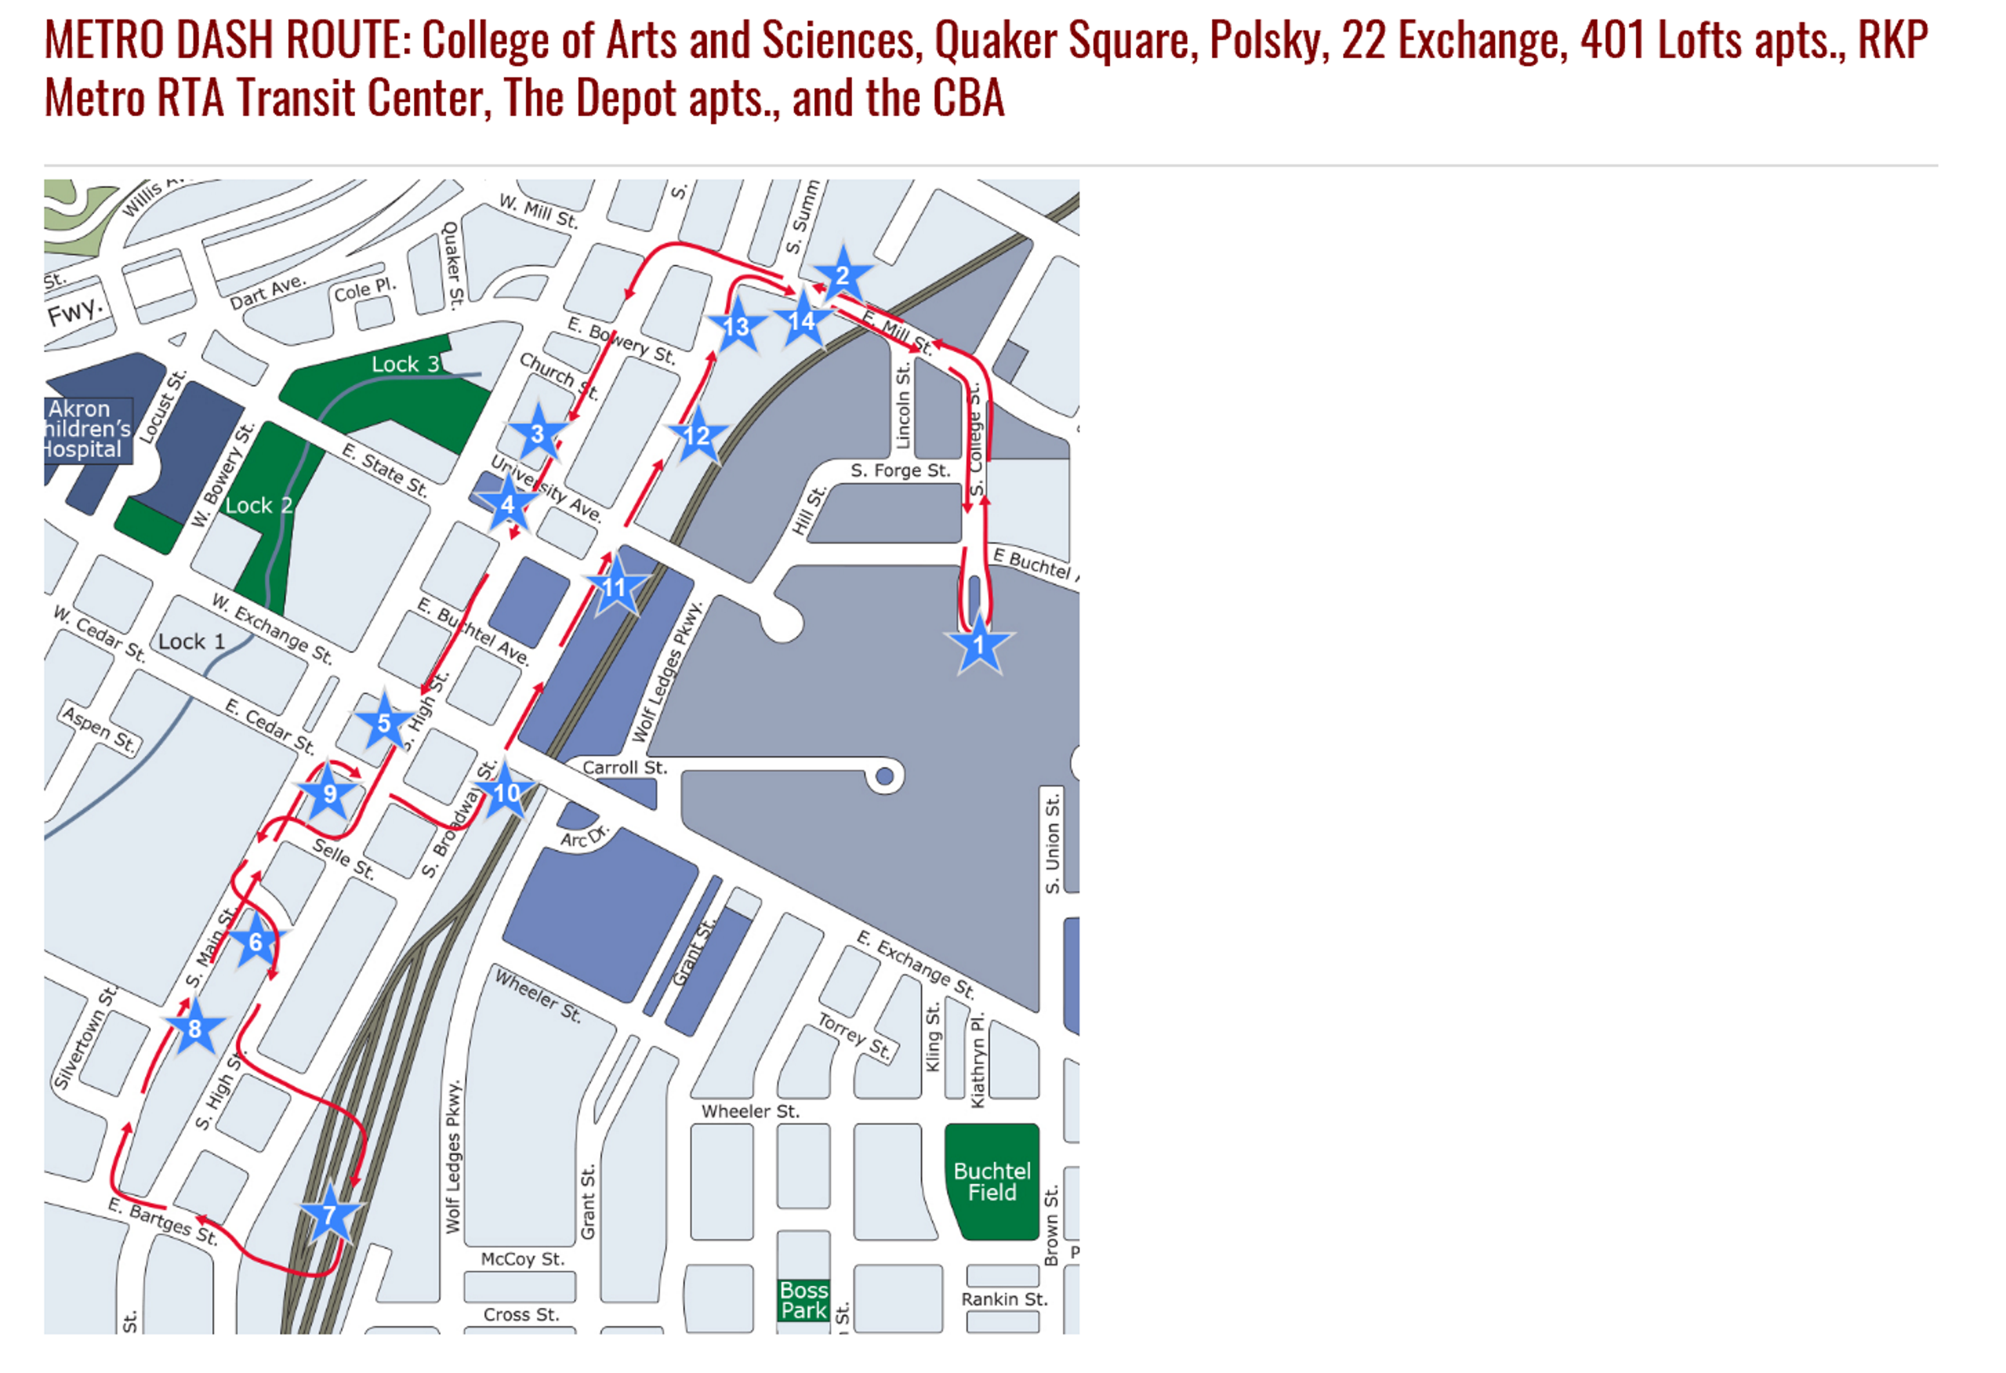
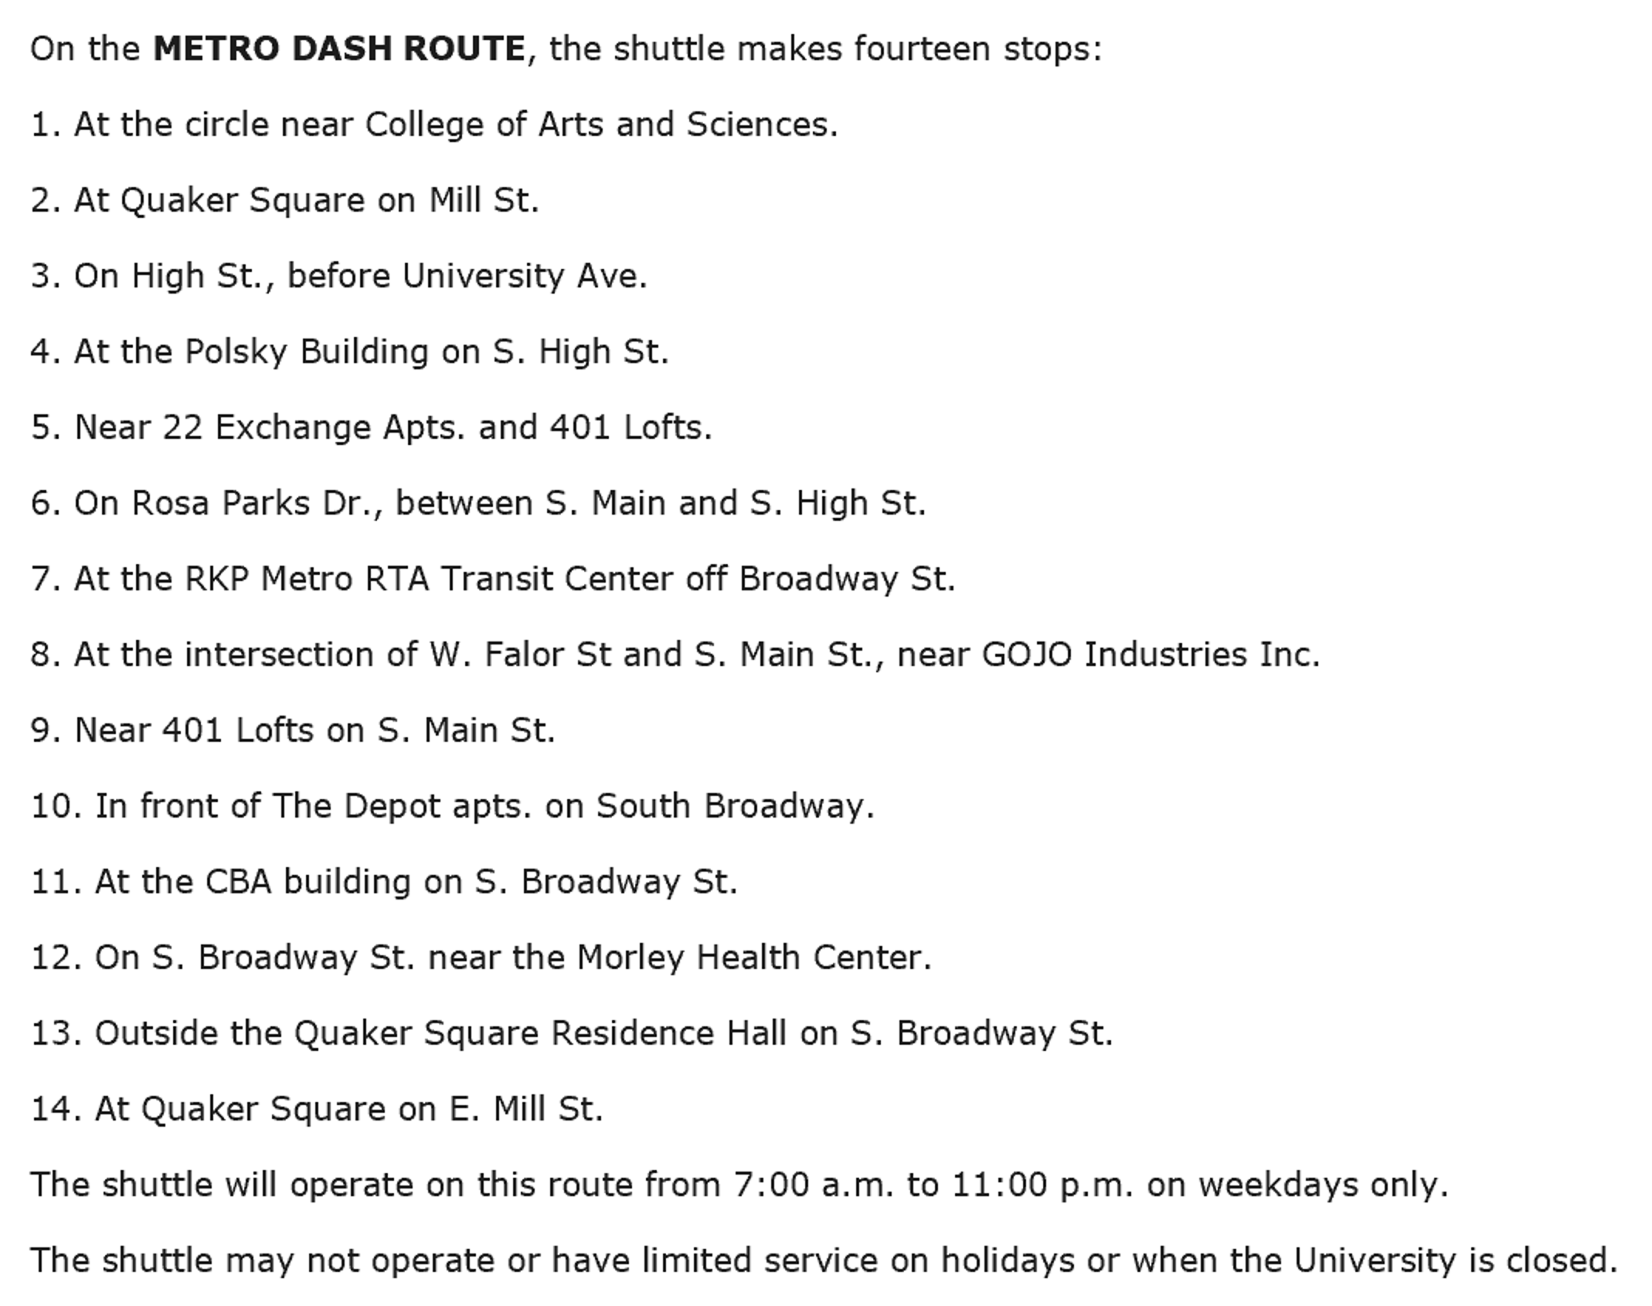
How to get around?
https://www.uakron.edu/parking/

Slide 18
How to get around?
https://www.uakron.edu/parking/
Cycling Initiative
Bike Share – Through Student Recreation and Wellness Center

Slide 19
Recreational Activities
https://uakron.edu/rec/

Slide 20
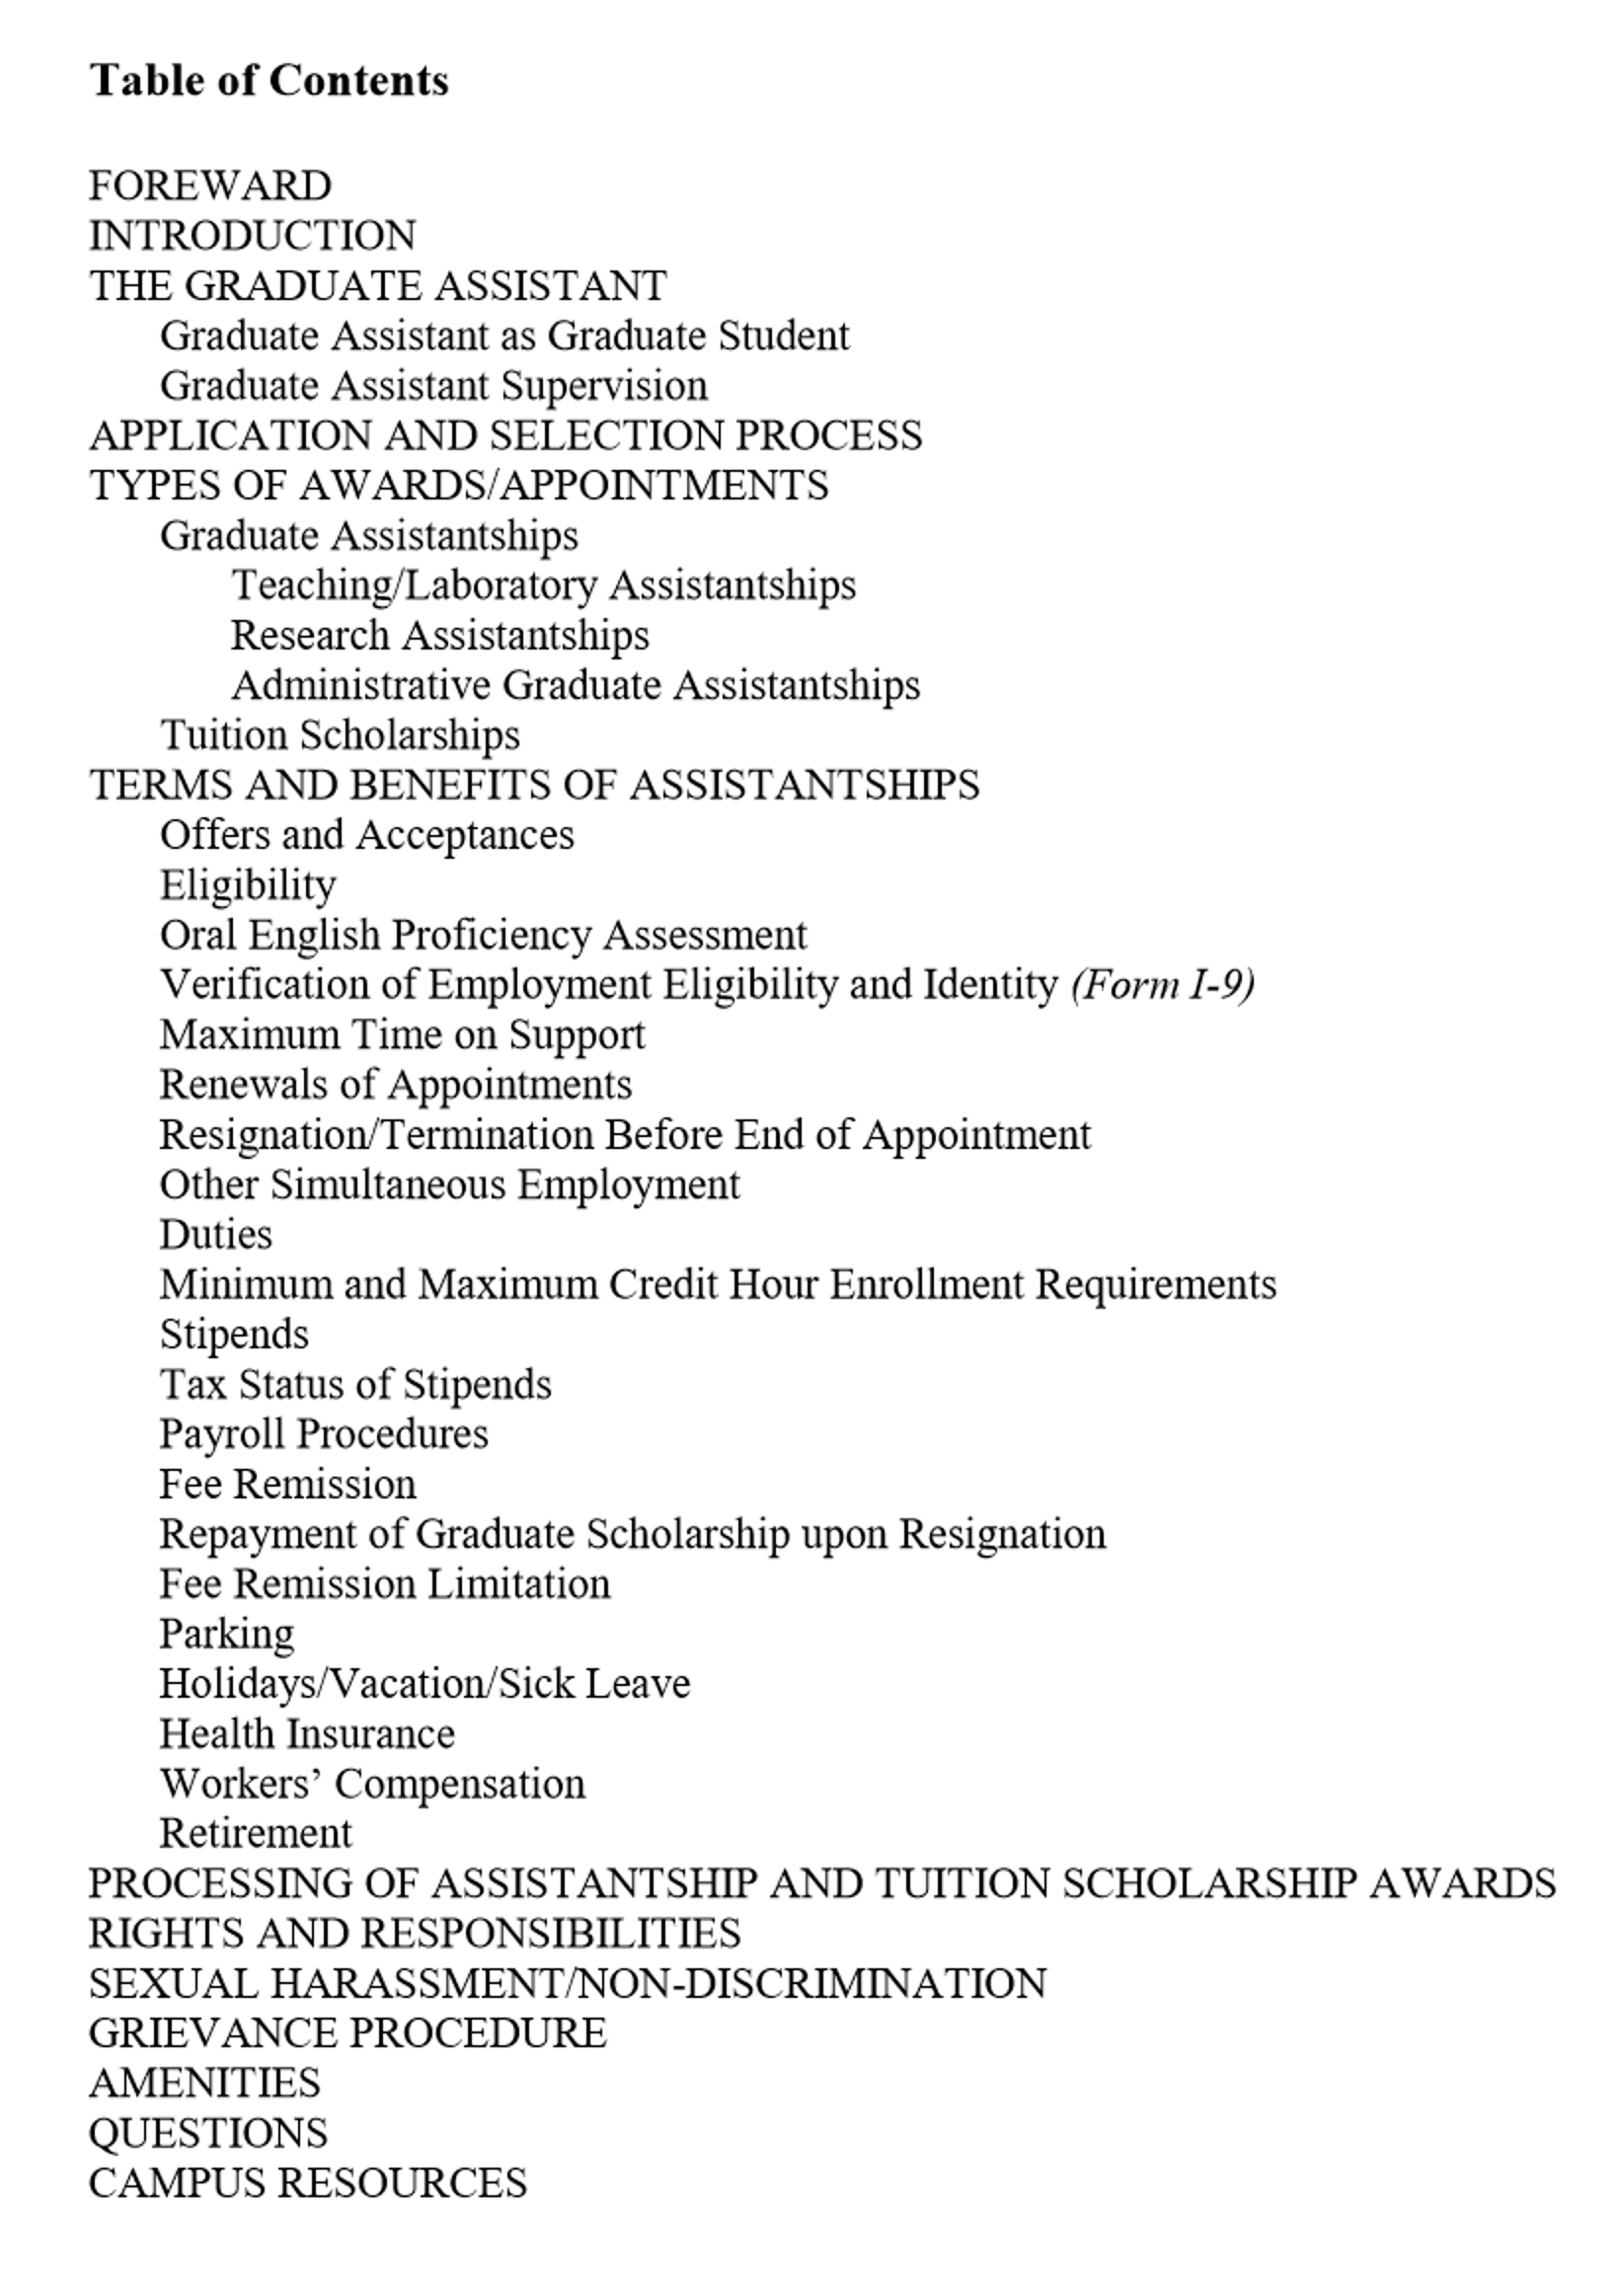
Why you’re here - ACADEMICS
https://www.uakron.edu/dotAsset/678001.pdf
The Graduate Assistant Handbook
Your primary reference guide

Slide 21
ACADEMICS-
Eligibility for a Graduate Assistantship
Full Admission to a Graduate Program
You must be enrolled as a full-time student during each semester you are working as a graduate assistant.
Full-time definition
Fall and Spring – minimum of 9 hours
Summer – minimum of 6 hours
Maintain a minimum cumulative 3.0 GPA and progressing toward degree completion
Maximum work hours may not exceed 20 hours/per week
Students may not hold additional employment if on a full-time assistantship

Slide 22
ACADEMICS-
Maintaining a Graduate Assistantship
You are required to perform your graduate assistantship duties satisfactorily
You must maintain the standards of academic conduct
You must honor the terms of your contract agreement
If a TA – you must meet the minimum oral proficiency requirement
23 – TOEFL Speaking Component (Internationals)
Assessed by departmental procedures (domestics)
If you give up your assistantship – you also give up the tuition waiver – repayment is required (after Census date)

Slide 23
ACADEMICS-
FEE REMISSION FOR GRADUATE ASSISTANTS (GAs)
UA shall provide a scholarship during each semester or summer session of award
Scholarships are not provided for:
undergraduate/audit courses professional fees
administrative fees facilities fees
technology fees drop/add fees
library fees miscellaneous fees
general service fees late registration fees
tuition/fees at other institutions

Slide 24
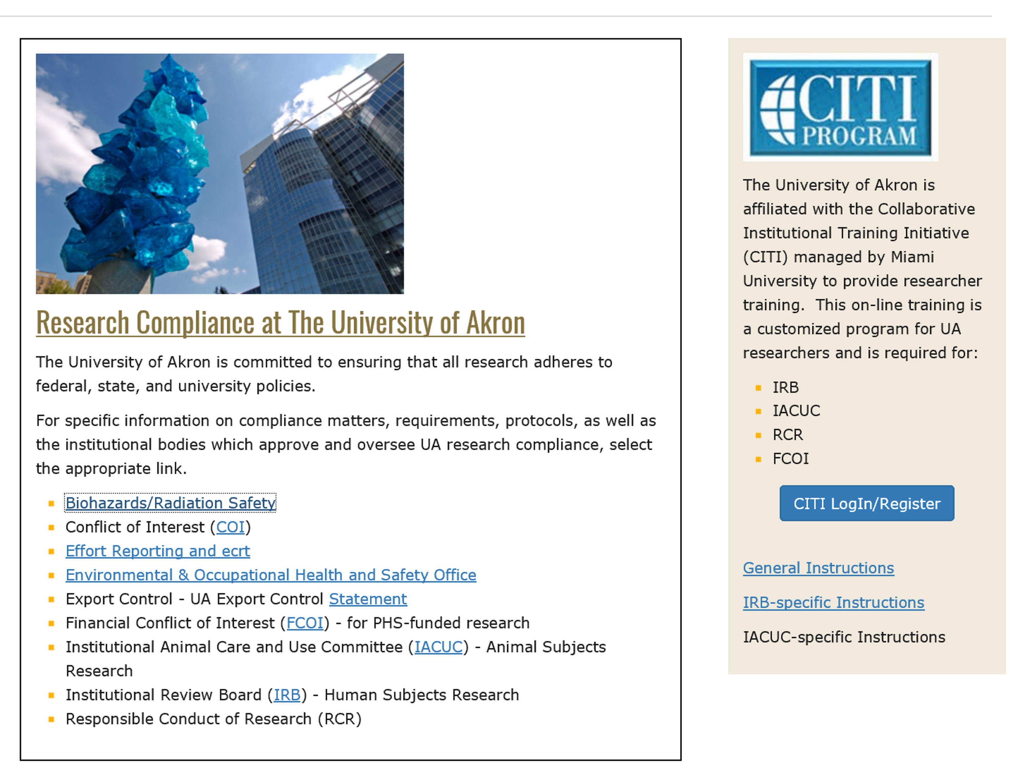
ACADEMICS-
OFFICE OF RESEARCH ADMINISTRATION
https://www.uakron.edu/research/ora/

Slide 25
Payroll- Eligibility (Diane Shovestull)
I-9 Forms
All Graduate Assistants are required to complete the I-9 form for the Graduate School
You will fill out the I-9 in your home department
You will not be paid until the Graduate School has received your I-9
Purpose – to document that both citizens and non-citizens are authorized to work in the US. It is required by Homeland Security and MUST be completed by ALL graduate assistants.
Most commonly accepted identification is passport or driver’s license AND social security card – list of acceptable documents on website

Slide 26
Payroll Forms
International students: e-mail Brenda McHenry at mchenry@uakron.edu
2018 W-4 Form/Ohio IT-4 Form
Form SSA-1945
Direct Deposit Form (pick-up 1st paycheck)
OPERS Exemption Form or Election Form for Students
Hired on or after September 28, 2016
SERS Exemption Form or Membership Record
30 days from date of hire to submit an exemption form
Forms available on the Payroll Forms web page

Slide 27
Graduate Teaching Assistants
If you are an active member in State Teachers Retirement System of Ohio (STRS) and you are not on a leave of absence from a teaching position covered by STRS Ohio, you may apply for exemption from contributions to STRS Ohio.
Please consult the STRS Ohio website at https://www.strsoh.org/employer/forms.html for more information and an “Exemption from Contributions for Student Employees” form.
If you are an active member in State Teachers Retirement System of Ohio (STRS) and on a leave of absence from a teaching position covered by STRS Ohio, or wish to contribute to STRS Ohio, you must complete a “Member Information” form.
The form is available on the STRS Ohio website at https://www.strsoh.org/employer/forms.html .

Slide 28
Biweekly payroll schedule
https://www.uakron.edu/controller/payroll.dot
Submit all Payroll forms to the Payroll Office:
Administrative Services Building (ASB) Room 102
185 East Mill Street, Akron, Ohio 44325
Questions?
Contact | Last Name Begins With | Ext
Sue Allshouse | A – Da | 6759
Carla Corsaro | Db – Hul | 6555
Ruth Roberts | Hum – Mi | 6558
Annemarie Crouse | Mo – Sh | 6553
Sandy White | Si – Z | 7206

Slide 29
Questions

Slide 30
SCHEDULE:
9:00-9:10 Graduate School Welcoming Remarks, Dean Chand Midha
9:10-9:50 - Graduate School Introduction, Marnie Saunders
9:50-10:00 – Diane Shovestull, Payroll
10:00-10:30- Code of Conduct and Title IX, Dean of Students, Michael Strong
10:30-11:00- ITL, Michelle Byrne
11:00-11:15 - Break
11:15-11:30 - Office of Inclusion, Jolene Lane
11:30-12:15 – Design and Developmental Services, Brightspace overview/demo

Slide 31
SAVE Training
Dean of Students Office

Slide 32
SCHEDULE:
9:00-9:10 Graduate School Welcoming Remarks, Dean Chand Midha
9:10-9:50 - Graduate School Introduction, Marnie Saunders
9:50-10:00 – Diane Shovestull, Payroll
10:00-10:30- Code of Conduct and Title IX, Dean of Students, Michael Strong
10:30-11:00- ITL, Michelle Byrne
11:00-11:15 - Break
11:15-11:30 - Office of Inclusion, Jolene Lane
11:30-12:15 – Design and Developmental Services, Brightspace overview/demo

Slide 33
SCHEDULE:
9:00-9:10 Graduate School Welcoming Remarks, Dean Chand Midha
9:10-9:50 - Graduate School Introduction, Marnie Saunders
9:50-10:00 – Diane Shovestull, Payroll
10:00-10:30- Code of Conduct and Title IX, Dean of Students, Michael Strong
10:30-11:00- ITL, Michelle Byrne
11:00-11:15 - Break
11:15-11:30 - Office of Inclusion, Jolene Lane
11:30-12:15 – Design and Developmental Services, Brightspace overview/demo

Slide 34
SCHEDULE:
9:00-9:10 Graduate School Welcoming Remarks, Dean Chand Midha
9:10-9:50 - Graduate School Introduction, Marnie Saunders
9:50-10:00 – Diane Shovestull, Payroll
10:00-10:30- Code of Conduct and Title IX, Dean of Students, Michael Strong
10:30-11:00- ITL, Michelle Byrne
11:00-11:15 - Break
11:15-11:30 - Office of Inclusion, Jolene Lane
11:30-12:15 – Design and Developmental Services, Brightspace overview/demo

